Slide 1
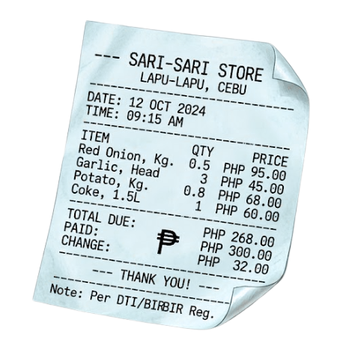
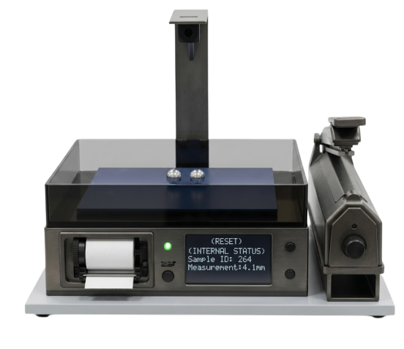

Automated Produce Scanner with Real - Time Pricing and Packaging
Maria Jeni Louise Brillas
John Carlo T. Gonzales
Jean Rose S. Jamelano
Jeston Roem C. Lacson
Kane Maxine Aesha M. Magan

Slide 2
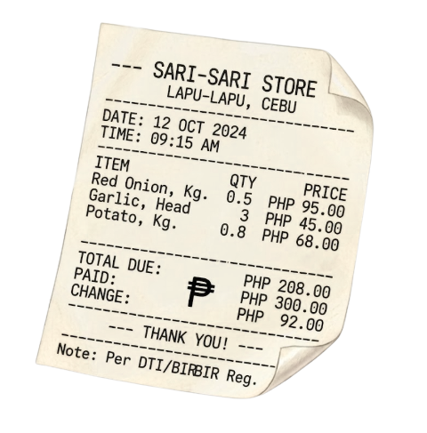
Abstract
This study developed a low-cost automated produce scanner using Raspberry Pi and Edge Impulse to automate vegetable detection, weighing, pricing, barcode labeling, and packaging. Evaluation results showed high usability, reliability, and efficiency, while the system demonstrated accurate pricing, stable weighing performance, and reliable barcode generation for retail applications.

Slide 3
Introduction
This study developed an automated produce scanner that integrates image detection, weighing, real-time pricing, barcode labeling, and packaging to improve efficiency and reduce transaction errors in fresh produce retail operations in Bacolod City.

Slide 4
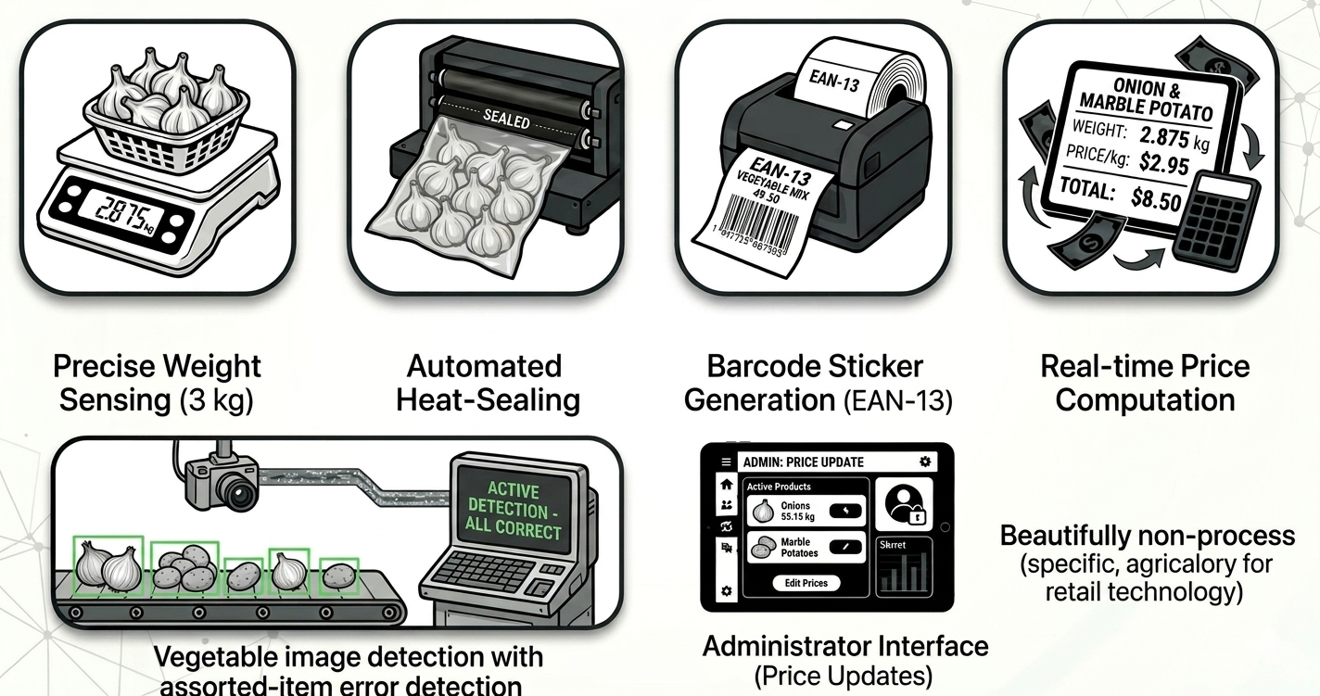
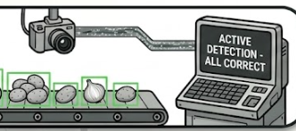
Features
Vegetable image detection with assorted-item error detection
Real-time price computation and LCD display
Precise weight sensing up to 3 kg
Automated heat-sealing mechanism

Slide 5
Features
Barcode sticker generation (EAN-13 format)
Administrator interface for updating prices

Slide 6
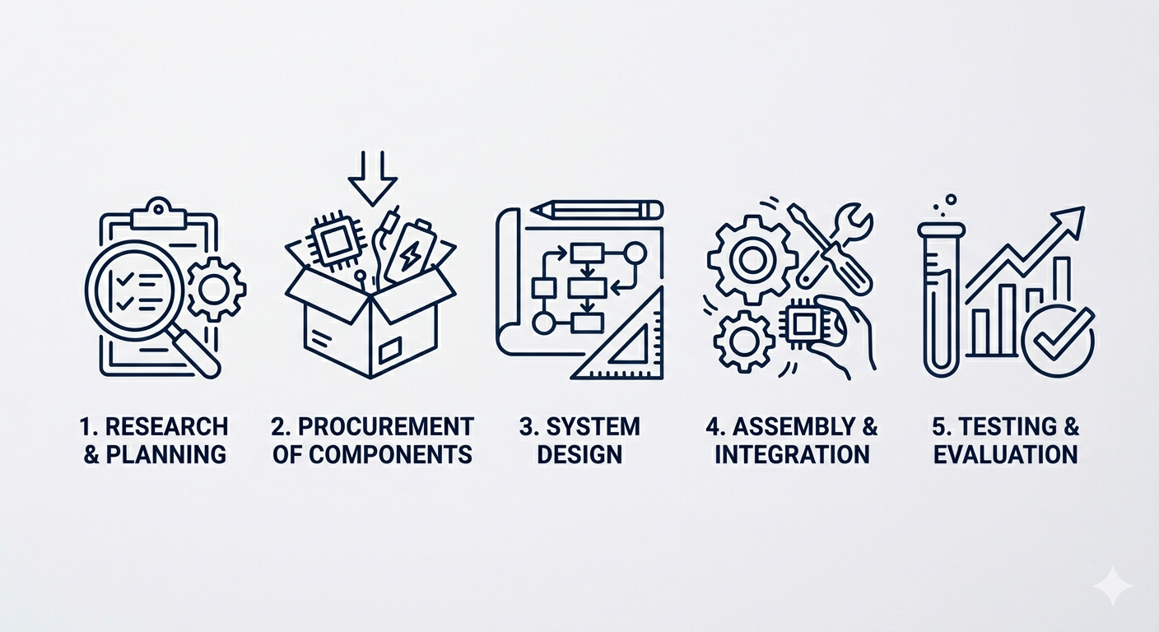
Methodology
1. Research and Planning
2. Procurement of Components
3. System Design
4. Assembly and Integration
5. Testing and Evaluation

Slide 7
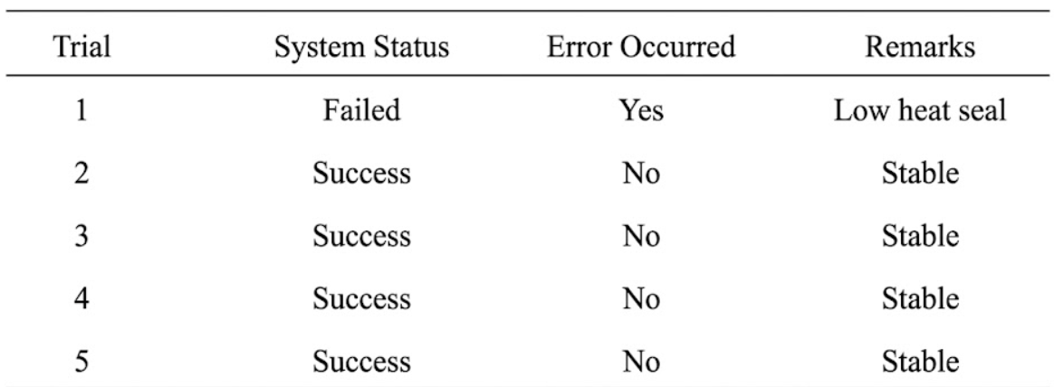
Results
Table 1. Evaluation in Consistency of the Prototype

Slide 8
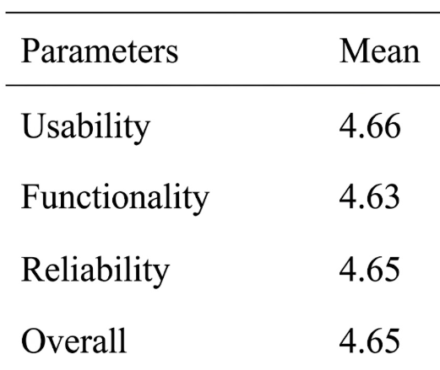
Results
Table 2. Evaluation Results of the Respondents

Slide 9
Discussion
The prototype achieved 80% system stability, with most trials successfully completing detection, weighing, computation, and barcode printing. It also received high evaluation ratings in usability, functionality, and reliability, indicating strong performance and user acceptance.

Slide 10
Conclusion and Recommendation
The study concludes that the developed automated vegetable classification, weighing, and labeling system is functional, reliable, and effective for self-service retail. Using Raspberry Pi and Edge Impulse, it achieved accurate detection, pricing, barcode generation, and packaging. Future improvements are recommended in dataset expansion, lighting and weighing stability, hardware enhancement, and cloud-based or multi-terminal integration for more efficient and scalable retail operations.

